Slide 1
CASE STUDY Web Interface Enhancements
CSS and jQuery Implementations Kingslee Velu

Slide 2
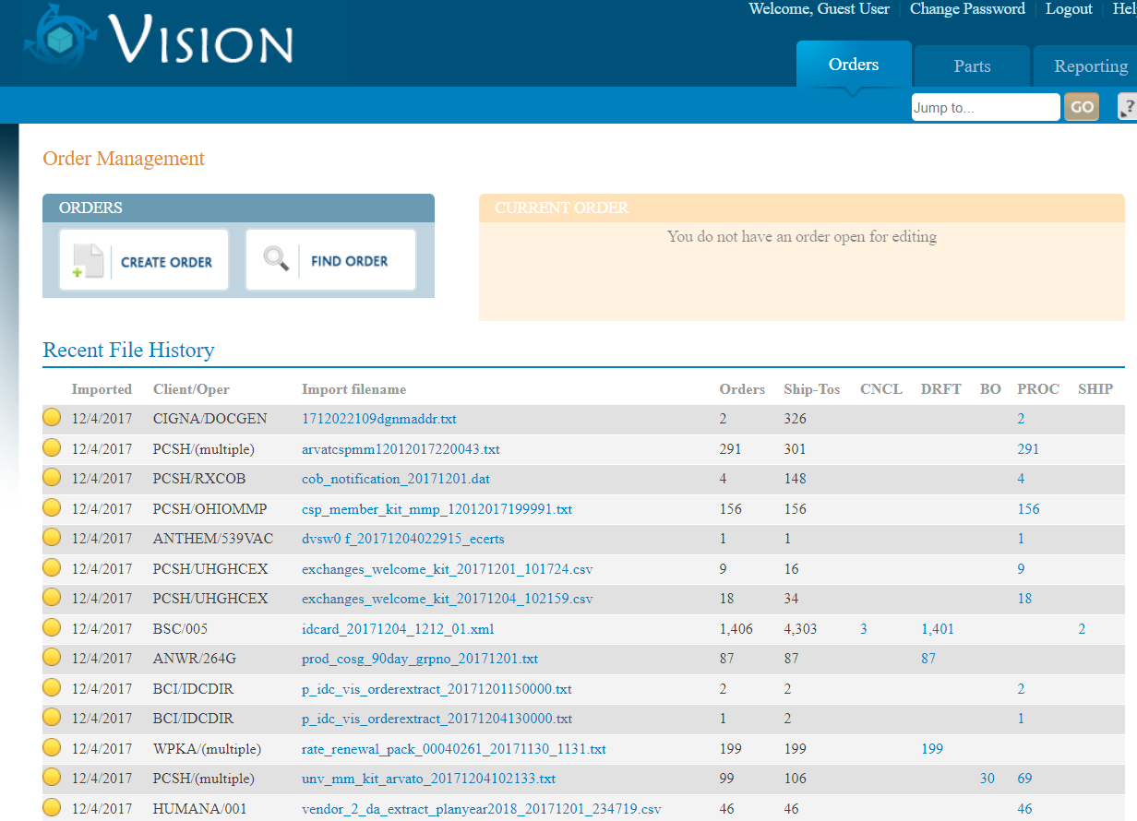
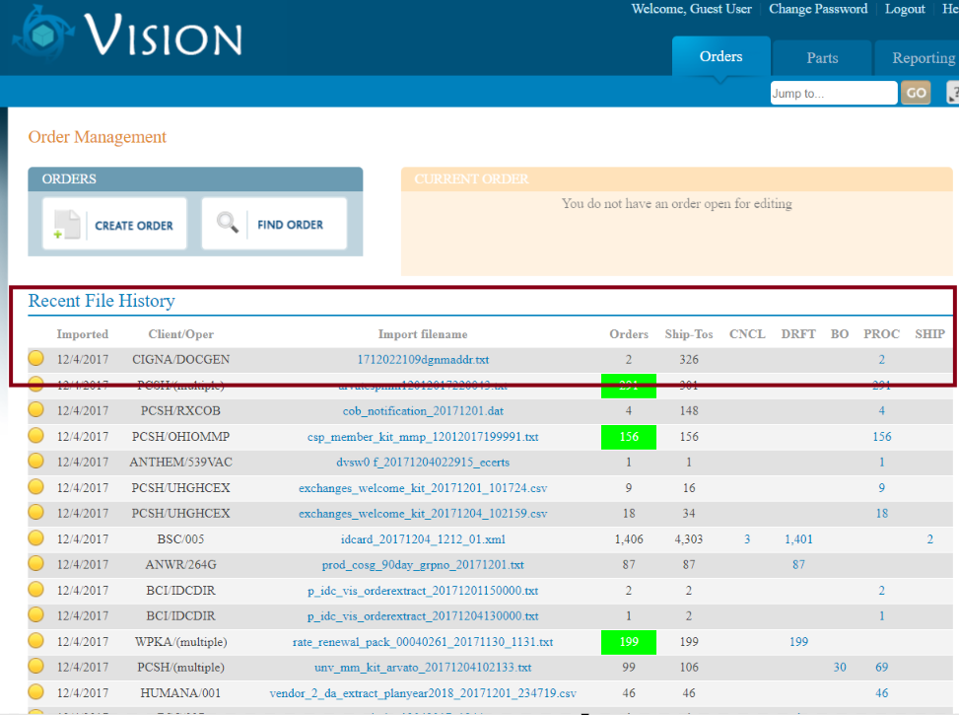
Test Case 1: Centered Column Headers
Adjust CSS to center all column headers and their data unless the text content length is higher than 20.
Before Image
After Image

Slide 3
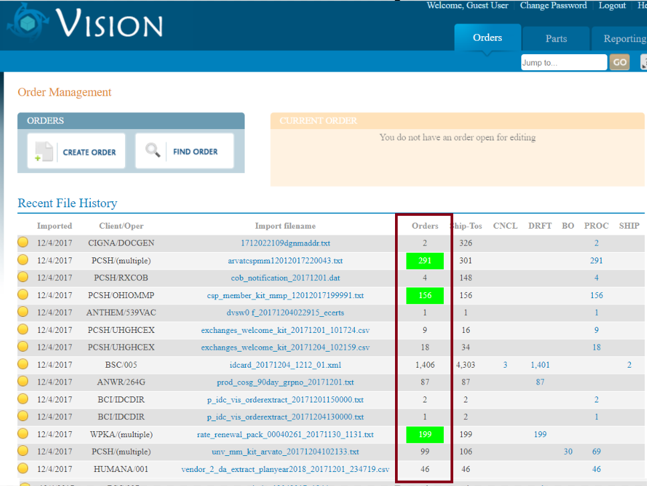
Test Case 2: Highlighting Orders
Use jQuery/CSS to highlight orders higher than 100 with a green background (#00FF00) and white text (#FFFFFF).
Before Image
After Image

Slide 4
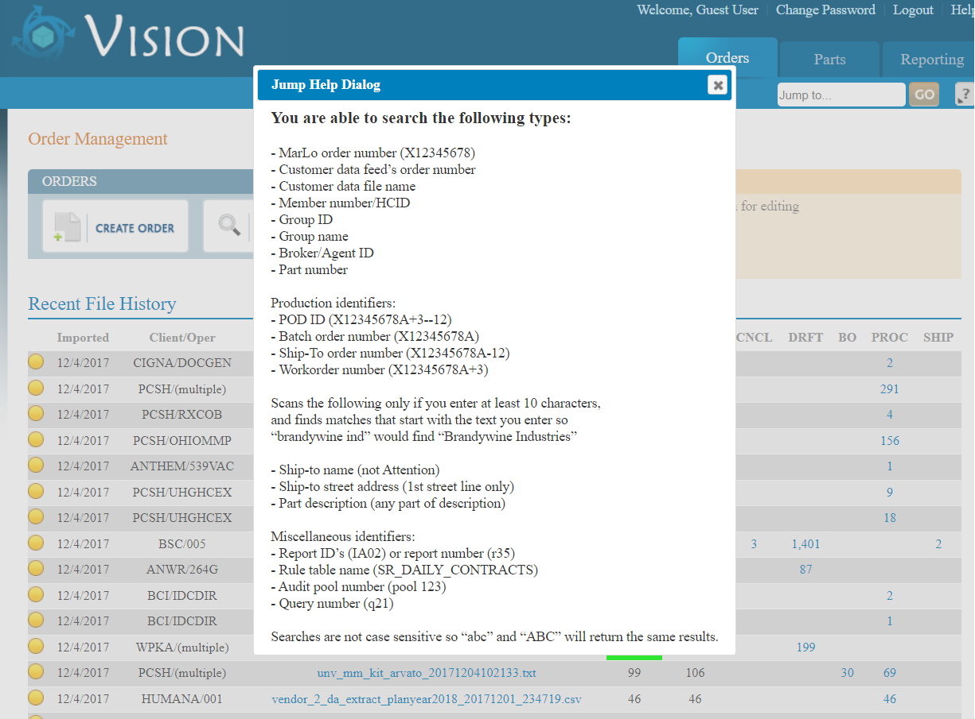
Test Case 2: Interactive Dialog Creation
Create a click event for 'jumpHelp' to open a dialog with 'dialog-jump' contents.
Before Image
After Image

